Slide 1
ELECTRICITY BILL CALCULATOR

Slide 2
Team Number
23

Slide 3
TEAM MEMBERS
MANOJ. S -711718205025
MITHUN SANTHOSH. Y -711718205026
NANDHINI.M -711718205027

Slide 4
Guided by:
Academic Mentor:
Prof. Mr. S. Rajasekaran.
Industry Mentor:
Ms. U. Subashini .
Associate KGISL GSS

Slide 5
MAIN OBJECTIVE:
To develop a mini project on “Electricity Bill Calculator” using Python programming and GUI.

Slide 6
ABSTRACT:
The title of the project is “Electricity Bill Calculator”. It is an GUI Computer application which is used to help the user to calculate their Electricity payment bills according to their consumption with respect to Tariff rates which is given by TNEB. It has three tariff that includes Domestic, Commercial and Industry. User can enter their consumption in units and can select their tariff type and computation done based on the tariff category which is already specified.

Slide 7
Existing System:
In today’s scenario the EB bill is auto calculated and the bill payments are done through online transaction. The common people are not aware of how the units of consumption is calculated according to the tariff.

Slide 8
Proposed System:
In our system , we create an user friendly GUI for the user to easily understand and interact with it and enter the units and calculate easily.

Slide 9
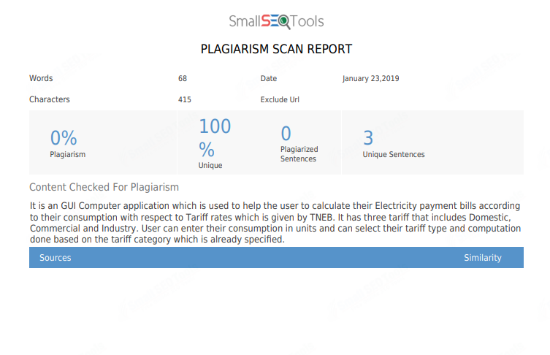

Slide 10
Model architecture:
start
user
home
Options for locality
Enter units
Calculation
Charges
Stop

Slide 11
ELECTRICITY
DOMESTIC
COMMERCIAL
INDUSTRY

Slide 12
Modules :
Welcome Module
Presentation Module
Calculation Module
Outcome module

Slide 13
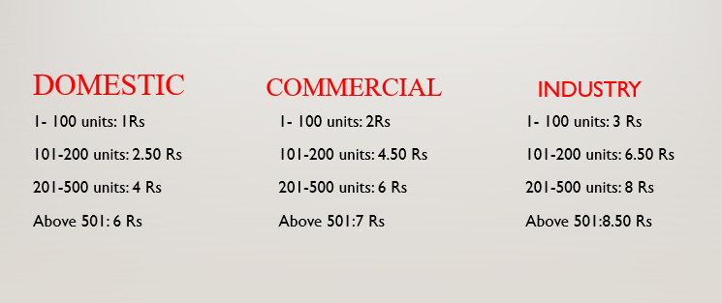
PRESENTATION MODULE

Slide 14
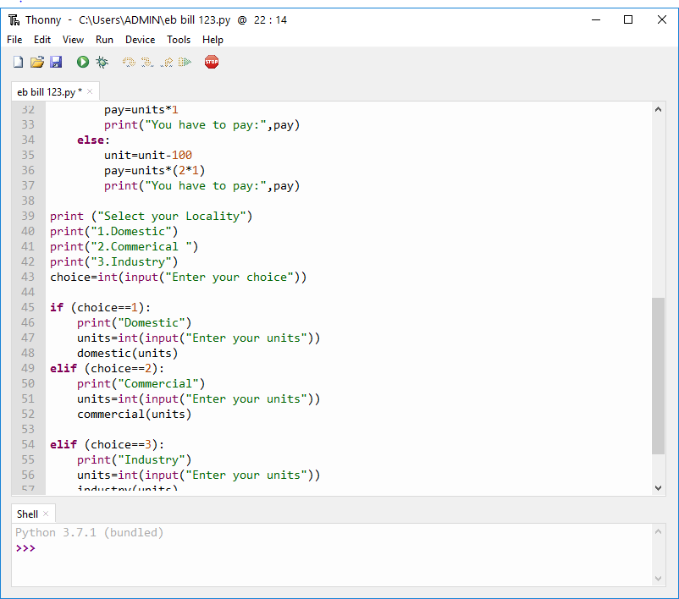
Sample code:

Slide 15
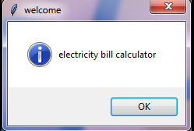
USER INTERFACE

Slide 16
MERITS:
By using this application user can calculate their EB charges without any external help

Slide 17
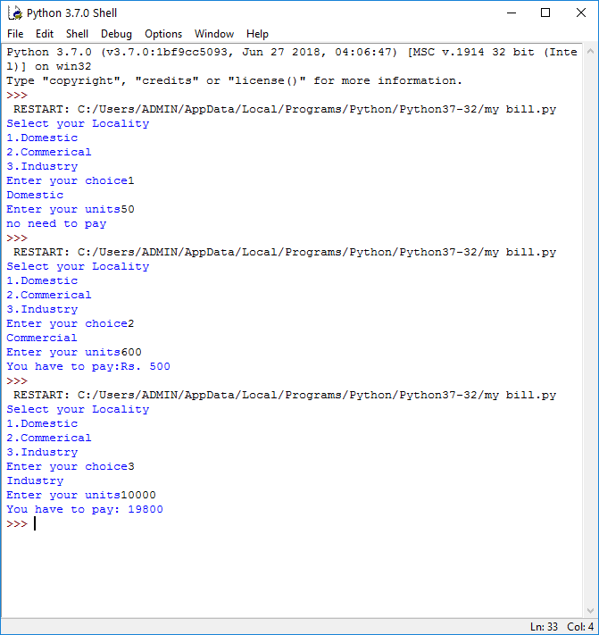
Outcomes:

Slide 18
Conclusion:
The Electricity bill calculator has been developed in python using Tkinter gui and deployed successfully.

Slide 19
References:
https://www.tangedco.gov.in/linkpdf/ONE_PAGE_STATEMENT.pdf
https://realpython.com/tutorials/advanced/
https://tkdocs.com/tutorial/install.html
https://likegeeks.com/python-gui-examples-tkinter-tutorial/#Adding-a-button-widget

Slide 20


Slide 21


